Slide 1
Building voter support for libraries
From Advocacy to Activism
Telling Your Best Story
#MSlib2017
John Chrastka, @everylibrary
Notes:
Good morning
Thank you
Introduce ourselves

Slide 2
First Nationwide PAC for Libraries
Set up as a c4 rather than a c3
61 Campaigns to date
41 wins
$210+ million in stable tax funding
Pro Bono Approach
Notes:
*

Slide 3
Talking to Politicians
about Libraries
@everylibrary
Building voter support for libraries

Slide 4
Why Talk Politics and Libraries?
Your funders - elected officials - listen to voters.
Not all voters. Their voters.
Building voter support for libraries

Slide 5
Talking to Politicians about Libraries
Politicians respond to only two things - Money and People. We probably can’t get the money, but the data shows that libraries are well supported by the people. So we definitely get the people.
Your electeds listen to their voters. They will be responsive if you can speak not only to the needs of your community, but also why and how the librarians are a partner in addressing those needs.
Your electeds have an agenda. They can be responsive if your ask aligns with a core reason that they ran for office.
Building voter support for libraries

Slide 6
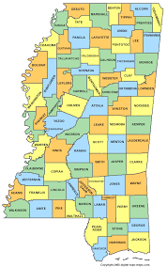
Boundaries and Lines Matter for Budgets

Slide 7
How to Win Over
Elected and Appointed Officials
@everylibrary
Building voter support for libraries

Slide 8
“We got it because we asked”
Building voter support for libraries

Slide 9
But You Need to Ask
Elected officials get a lot of "asks". If we don't ask, we don't get heard. If we are not in line when the line moves, it moves without us. If we're not 'fundable', when the funding comes we're not going to get any.
What makes us fundable?
Do you have the authorization to be in the appropriations?
When can we change the authorizing language?
Building voter support for libraries

Slide 10
Researching Your Electeds and Appointeds
What committees does your elected sit on (policy/budget/approps) that libraries are part of?
What committees does your elected sit on (policy/budget/approps) that libraries have never been in?
What caucuses are your electeds involved in that may not normally look at libraries?

Slide 11
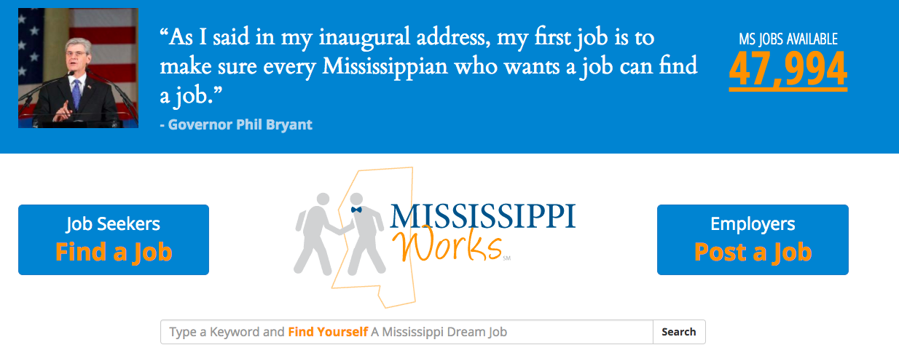
Mapping Your Ask to Your Electeds’ Priorities

Slide 12
Mapping Your Ask to (Local) Officials’ Priorities
@everylibrary
Building voter support for libraries
Notes:
After Lunch [PC]

Slide 13
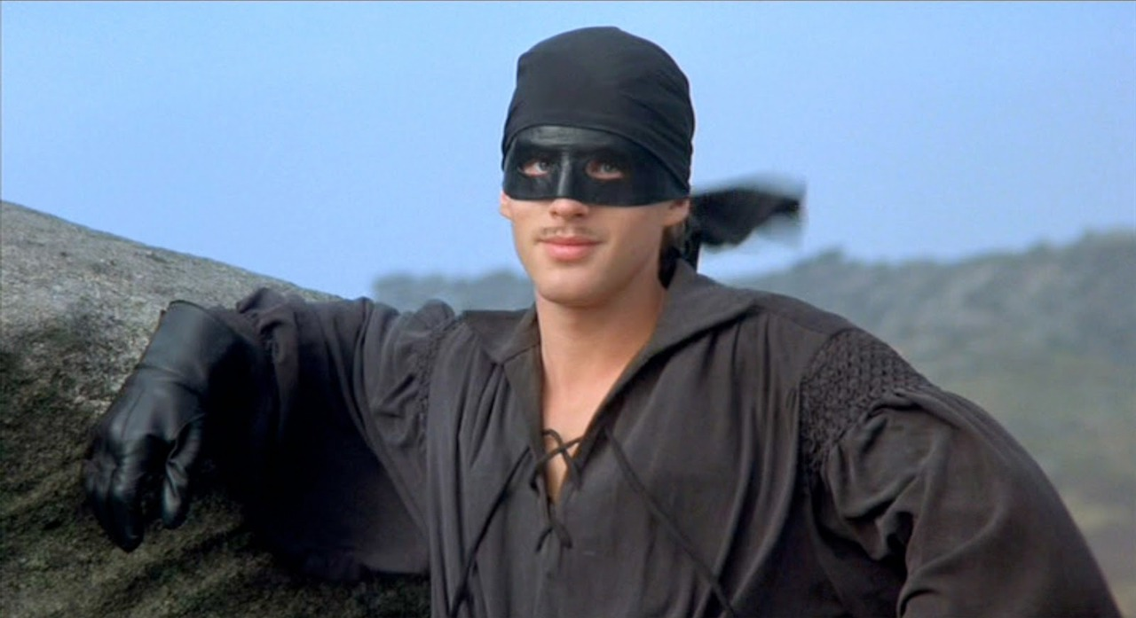
Guiding Principle: Dread Pirate Roberts

Slide 14
“Your brains, his strength, my steel”
Electeds are your neighbors. And they have the checkbook.
Present yourself as if you are there to help them accomplish their goals (not the other way around).This is an opportunity to start a relationship (not one off deal)
You are the best expert on 21st century libraries in your community.
You have on-the-ground, actionable intelligence about the neighborhood your elected is representing.
Building voter support for libraries

Slide 15
Pro-Tips for Elected and Appointed Officials
It is a discussion, not a debate.
Unless you know the elected is actually opposed or is on the record as true friend to libraries, assume they are neutral, interested, and unaware.
Building voter support for libraries

Slide 16
Conventional Wisdom Says….
Ask “open ended questions”...
What do you think of libraries?
What can libraries do for you and your position?
What can we (librarians) do to support your work?
Building voter support for libraries

Slide 17
Two Key Question for Legislators
How can libraries fitting into this budget / ordinance / bill?
How do you see librarians putting your idea to work in the community?
Building voter support for libraries

Slide 18
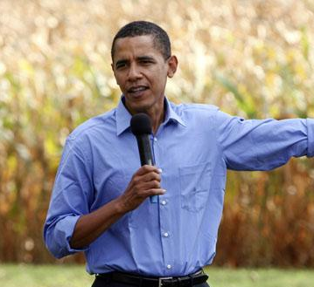
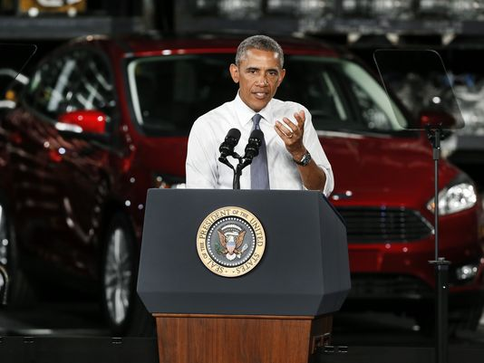
Keep it Relevant

Slide 19
Extending Your Influence
@everylibrary
Building voter support for libraries

Slide 20
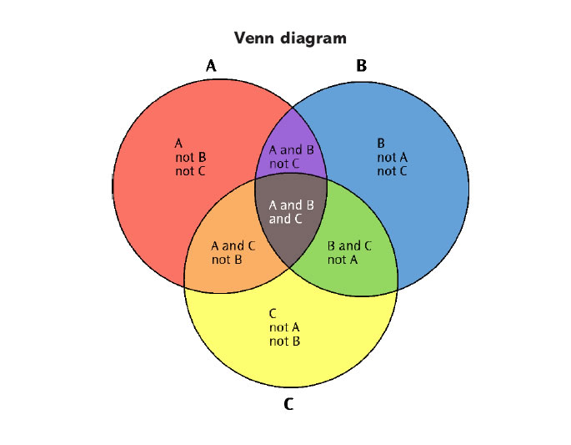
All Issues
are won by
Coalitions
Notes:
*

Slide 21
Extending Your Influence
What systems already exist in your community or statewide that align with libraries? Where are your natural partnerships? Who are you regularly frustrated with?
State and Local Systems:
Boards and Commissions
Coalitions of Common Cause
Coalitions of Common Concern

Slide 22
What Coalitions are Right for You?
Economic Development
Early Literacy and Early Childhood
Grade Level Reading
Housing and Food Security
Immigration
Safety and Violence

Slide 23
Making a New Ask
@everylibrary
Building voter support for libraries
Notes:
After Lunch [PC]

Slide 24
Making a New Ask
Where does the money come from?
What are the priorities of my elected or appointed officials?
What is “regular order” for the lawmaking or rulemaking body?
How can I make this easy for them?

Slide 25
Understanding Regular Order
Dates and Statutory Deadlines
Rules and Process for participation
How the budget / ordinance / bill starts
How the budget / ordinance / bill moves
How to amend ‘on the floor’
Backroom work still gets it done. Out front is political cover, political pressure, or political affirmation.

Slide 26
Making a “New Ask” Easier
We have developed model language for a budget / ordinance / bill that would address X or Y or Z.
Would you like to see it?
Building voter support for libraries

Slide 27
Making Your New Ask ‘Easiest’
@everylibrary
Building voter support for libraries
Notes:
After Lunch [PC]

Slide 28
Please Tell Your Story
@everylibrary
Building voter support for libraries
Notes:
After Lunch [PC]

Slide 29
Tell Some Great Stories
Blind and Handicapped Services (Home Delivery)
Core InterLibrary Loan
Special Collections, Archives and Genealogy
Summer Reading / Learning
24/7 Reference
Databases
Building voter support for libraries

Slide 30
Blind, Handicapped, and Home Delivery
Library resources are compassionate and change lives. It is a “transformational force”.
Libraries are one functioning unit of government in an otherwise dysfunctional system.

Slide 31
Marketing Plan
‘Record a Book’ marketing campaign:
“Do people tell you that you have a radio voice? The library needs your voice to be the eyes for thousands of our neighbors across our state….”

Slide 32
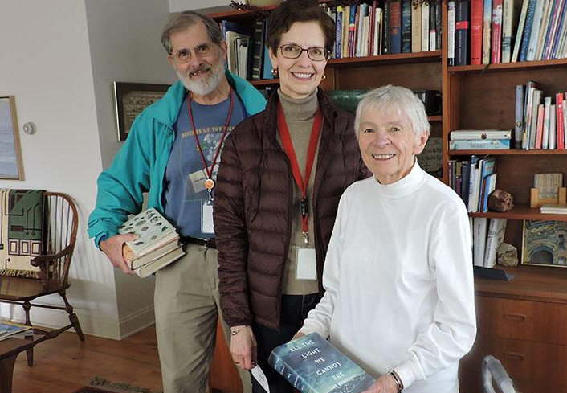
Marketing Plan
‘Deliver a Book, Save a Life’ marketing campaign:
“Our library is a lifeline to people across our community. We bring the library to folks who can’t easily leave their homes, connecting them to the outside world….”

Slide 33
Interlibrary Loan and Resource Sharing

Slide 34
New Frame on a Success

Slide 35
Marketing Plan
Smart Taxes: “Libraries across our state help local tax dollars go farther because of cooperative purchasing through our state library….”
Presentation Topic: “Interlibrary Loan through the state library is an enterprise level logistics and data solutions provider…”
Building voter support for libraries

Slide 36
Special Collections, Archives and Genealogy

Slide 37
Special Collections
Maine - Historic American Buildings Survey
“Collection of architectural drawings and blueprints of old houses and buildings from the Historic American Buildings Survey.”
Nebraska - Western Trails
“Find a wide range of artifacts, books, documents, maps, postcards, original paintings, and photographs on a variety of topics relating to trails in Nebraska. Collected into a searchable database from the holdings of museums and libraries across Nebraska....”
Alaska - Digital Archives
“Alaska's Digital Archives presents a wealth of historical photographs, albums, oral histories, moving images, maps, documents, physical objects, and other materials from libraries, museums and archives throughout our state.”

Slide 38
Special Collections

Slide 39
Marketing Plan
Start your {location} quest!
”Our (town) (county) matters. The story of how we got here, settled this place, and made it our home matters. Your library is….”
#everylibrary
Building voter support for libraries

Slide 40
Summer Reading / Learning

Slide 41
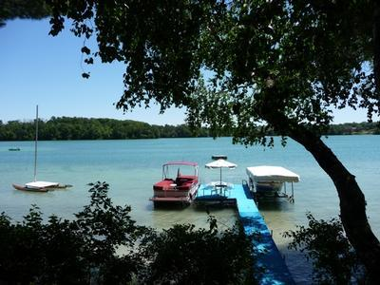
Going to the Lake...
How do we market all our libraries across the state?
How can we position the library card people carry as part of their travel plans?
Is there a way to enhance summer reading / learning?

Slide 42
Marketing Plan
“Pack Your Library Card” campaign
Get on the lists:
Trip Advisor, Fodor's, Lonely Planet
Parent-Travel Sites. Local Magazines,
Literary and Educational Travel Sites
#everylibrary
Building voter support for libraries

Slide 43
Happier Students = Happier Families

Slide 44
Marketing Plan

Slide 45
The Largest Classroom in the School is also the Most Child-Led
“Few things wipe away the brain-numbing effects of standardized testing like singing karaoke in the library, playing board games with friends, or experimenting with robotics during a specialized workshop. All of these activities promote social interaction and self-expression, and give young people a way to blow-off a little steam.”

Slide 46
Databases

Slide 47
Databases
“A library database is both an electronic catalog and the access point to information from published works. Library databases provide access to resources across a wide spectrum of topic and subject areas. Such as: the arts, genealogy, academic research, home improvement, auto repair, business and much more.”
#everylibrary
Building voter support for libraries

Slide 48
Databases, Nope
Describe business databases for what they are:
Market intelligence
Supply chain analytics
Research and metrics
Capacity building for intelligence iterative growth
@everylibrary
Building voter support for libraries

Slide 49
Databases = Huh?
Describe school library databases for what they are:
Supports and extends the curriculum
Unique resources for individualized learning and exploration
@everylibrary
Building voter support for libraries

Slide 50
My Invitation to Tell Your Stories
@everylibrary
Building voter support for libraries
Notes:
After Lunch [PC]

Slide 51
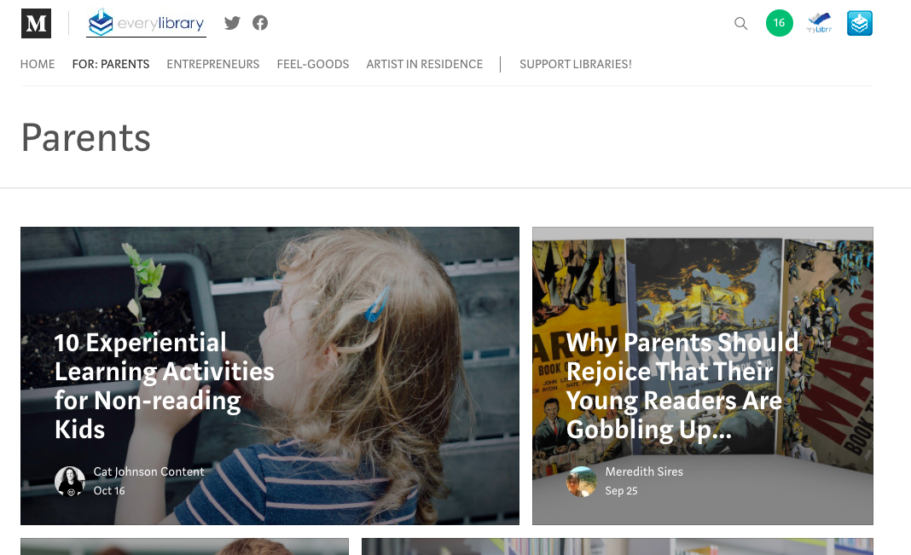
Medium.com/EveryLibrary
Notes:
John

Slide 52
Notes:
John

Slide 53
Thank You
John Chrastka
EveryLibrary
www.everylibrary.org facebook/everylibrary @everylibrary
Building voter support for libraries

